Slide 1
AtliQ Hospitality Analysis Presentation

Slide 2
Introduction
Atliq Grands, a prominent name in the hospitality industry with over two decades of experience, is currently facing challenges in maintaining its market share and revenue in the luxury/business hotel segment. In response to competitive pressures and management inefficiencies, the managing director has initiated a strategic initiative to implement "Business and Data Intelligence" solutions. These solutions aim to harness insights from historical data to revitalize market strategies and optimize operational performance.
With a focus on leveraging external expertise due to the absence of an in-house data analytics team, Atliq Grands has partnered with a third-party service provider. This collaboration seeks to analyze comprehensive datasets spanning across five critical dimensions: dim_date, dim_hotels, dim_rooms, fact_aggregated_bookings, and fact_bookings. The project entails developing modular, safe, testable, maintainable, and portable Python code to empower data-driven decision-making across various facets of hotel operations.

Slide 3
Details of Data
1. dim_date:
Description: Contains date-related information used for time-based analysis and filtering.
Columns: Typically includes date, month, year, week, weekday, etc.
2. dim_hotels:
Description: Provides details about different hotels owned by Atliq Grands across various cities.
Columns: Includes hotel_id, hotel_name, city, region, star_rating, etc.
3. dim_rooms:
Description: Describes the characteristics of rooms available in each hotel, such as room types and capacities.
Columns: Includes room_id, hotel_id, room_type, room_capacity, floor, etc.
4. fact_aggregated_bookings:
Description: Aggregated data related to bookings, typically used for summarizing booking trends and patterns.
Columns: Contains metrics like check_in_date, check_out_date, property_id, total_bookings, revenue_generated, etc.
5. fact_bookings:
Description: Detailed booking records capturing individual transactions and guest details.
Columns: Includes booking_id, booking_date, check_in_date, checkout_date, property_id, room_category, booking_platform, ratings_given, booking_status, revenue_generated, revenue_realized, etc.

Slide 4
Tools Used
For the project involving Atliq Grands in the hospitality industry to implement Business and Data Intelligence solutions, the tools used include Python for scripting and analysis, and Business Intelligence tools such as Power BI for visualization and dashboard creation. These tools are essential for leveraging historical data from the provided CSV files (dim_date, dim_hotels, dim_rooms, fact_aggregated_bookings, and fact_bookings) to derive insights and drive strategic decisions aimed at revitalizing market share and revenue in the luxury/business hotel sector.

Slide 5
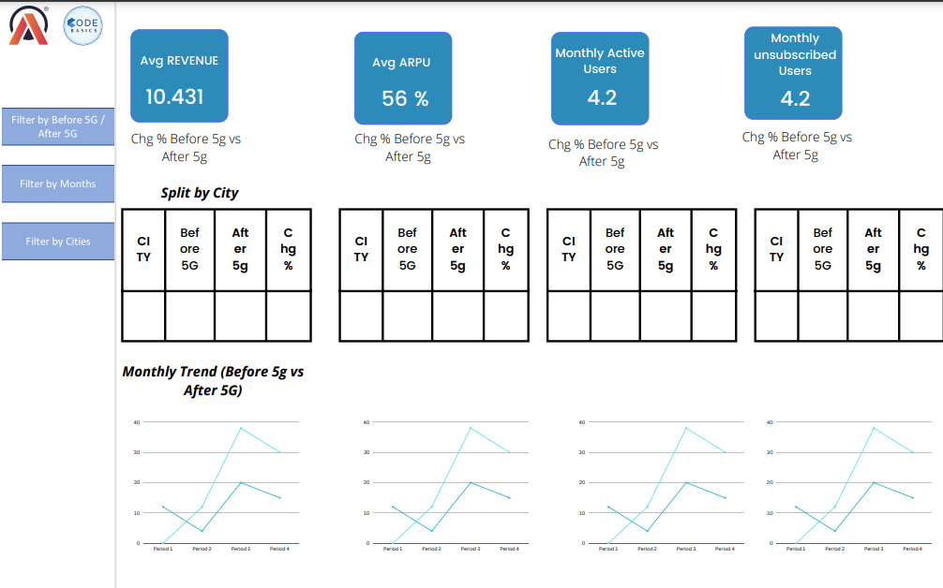
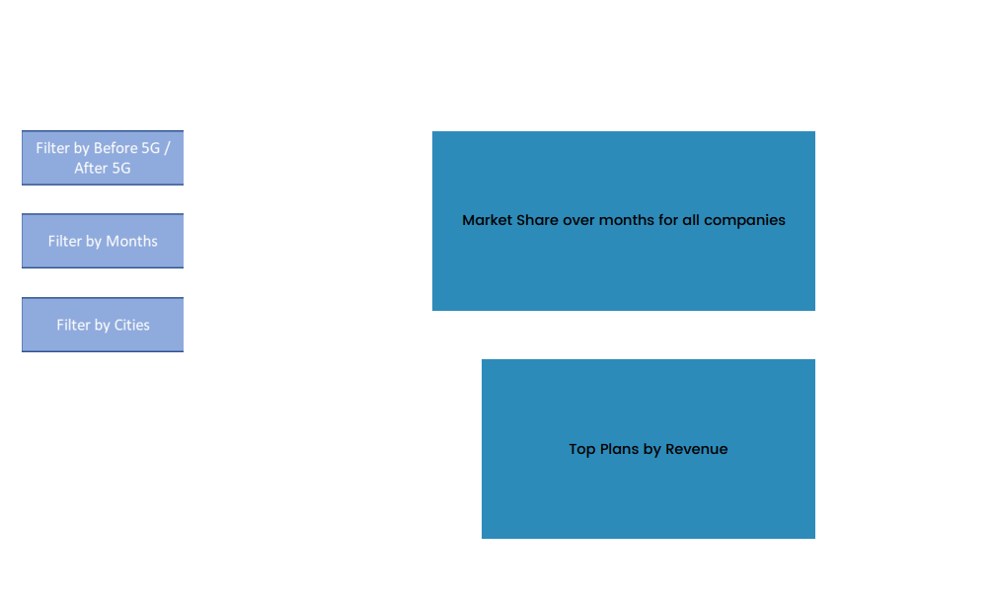
Mock – up Dashboard

Slide 6
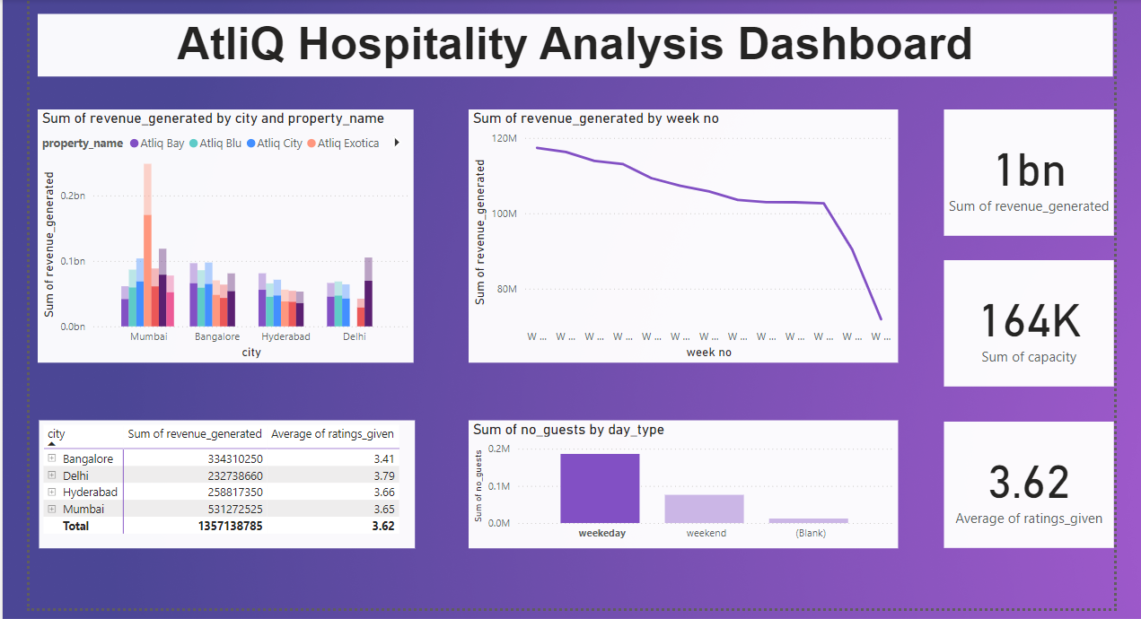
My Design

Slide 7
Thank You!

